Slide 1
Case: Boeing 737 Max Crashes
Group 4: Aditya Jain, Devendra Sonkeware, Parth Agarwal, Shagun Gupta,
Shivam Kartikeyan Atal

Slide 2
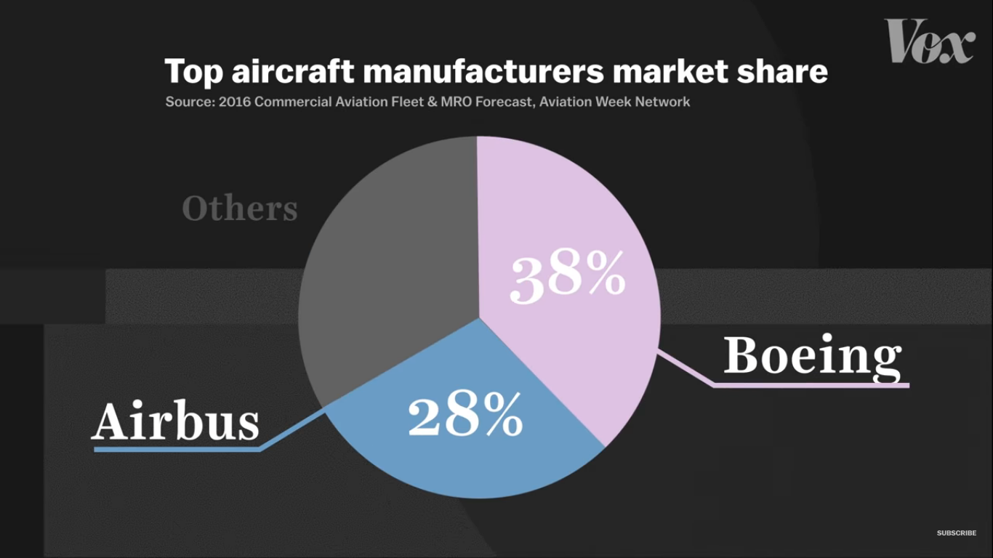
The Case
The two biggest manufacturers of aircrafts are Airbus & Boeing.
This has led to fierce competition between the two companies.

Slide 3
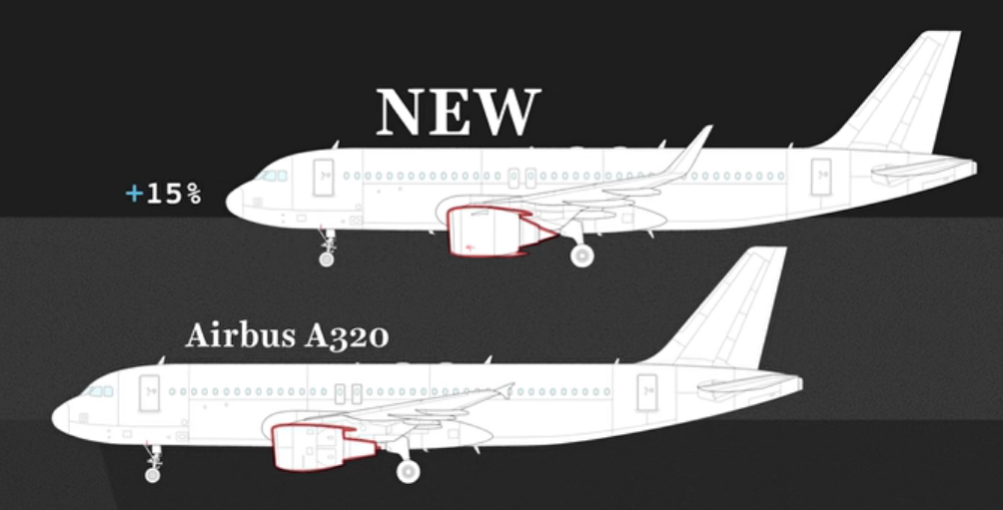
The Case
In 2010, Airbus updated their most successful aircraft model - Airbus A320.
This update increase the fuel efficiency of the aircraft by 15% - saving money to the airline industries.

Slide 4
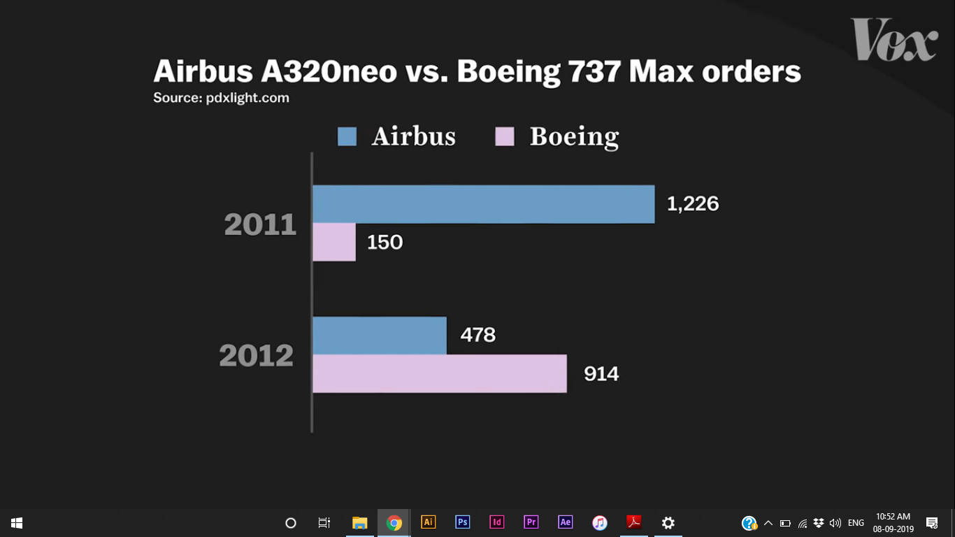
The Case
In 2011, Boeing release a similar update to their counterpart of A320 - Boeing 737-800 Max.
It was much more efficient.
Boeing said, it is so similar to the previous model that pilots could walk into the cockpits with minimal additional training.

Slide 5
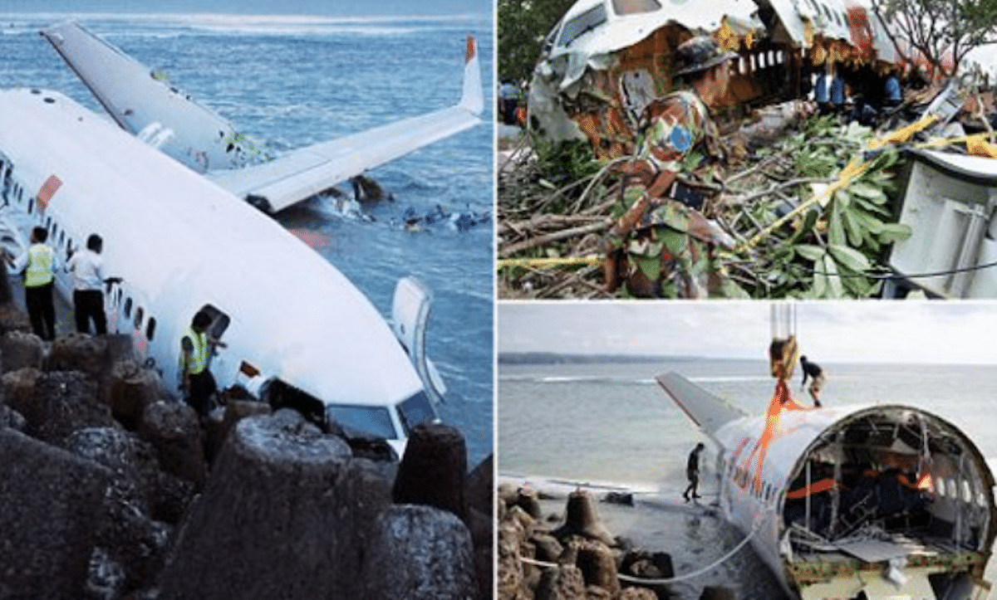
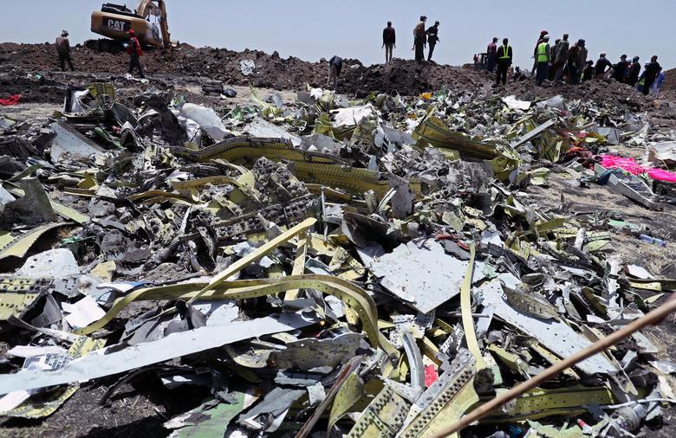
The Case: Two Major Accidents
In October 2018 , Lion Air Flight 610 crashed minutes after takeoff killing 189 people on board died
In March 2019 , Ethiopian Airlines Flight 302 crashed minutes after takeoff .
All 157 people on board died
Both these aircrafts were Boeing 737 Max!

Slide 6
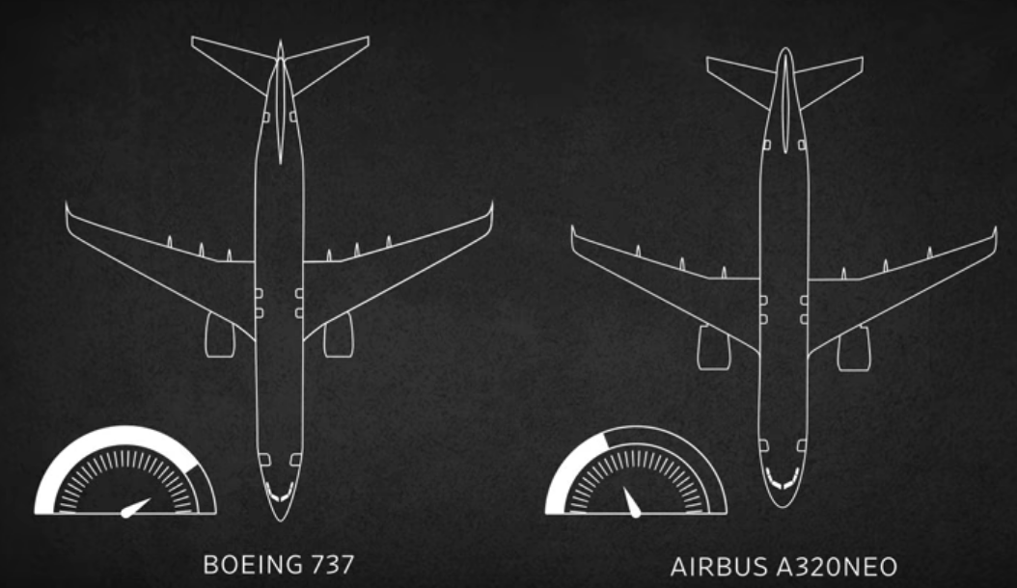
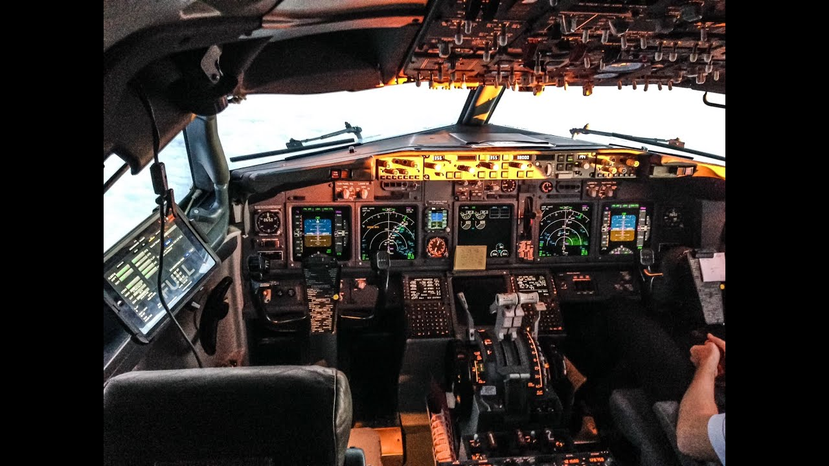
How it all Started
The updated Airbus A320neo had two benefits:
Higher fuel efficiency with a larger new turbo Engine
Due to the same design of the airplane no additional training for pilots

Slide 7
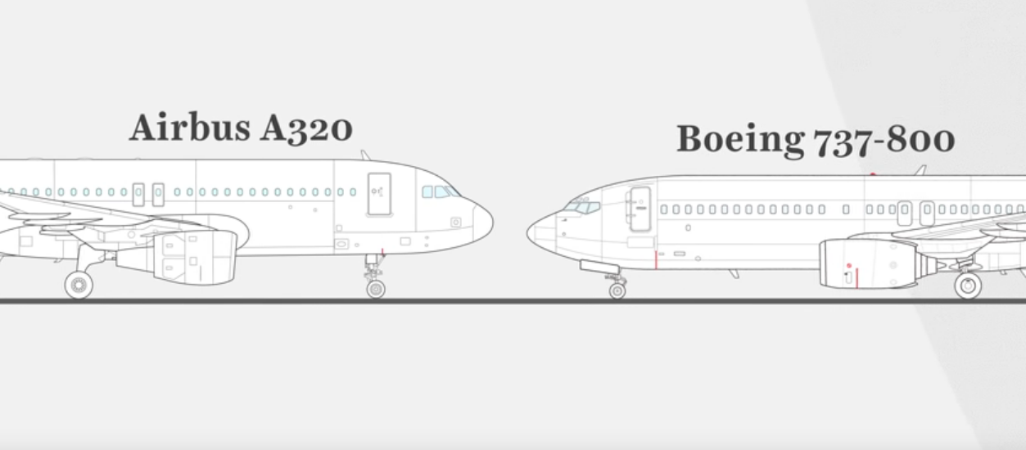
Boeing’s update
Installed the new Engine above the previous position in the A737MAX because it did not want to change the design too much.

Slide 8
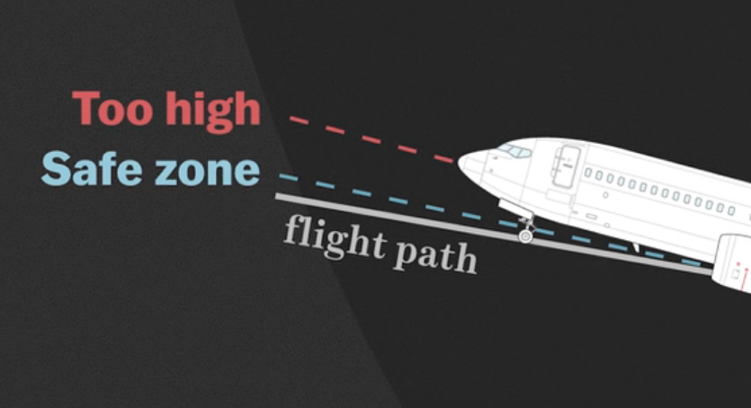
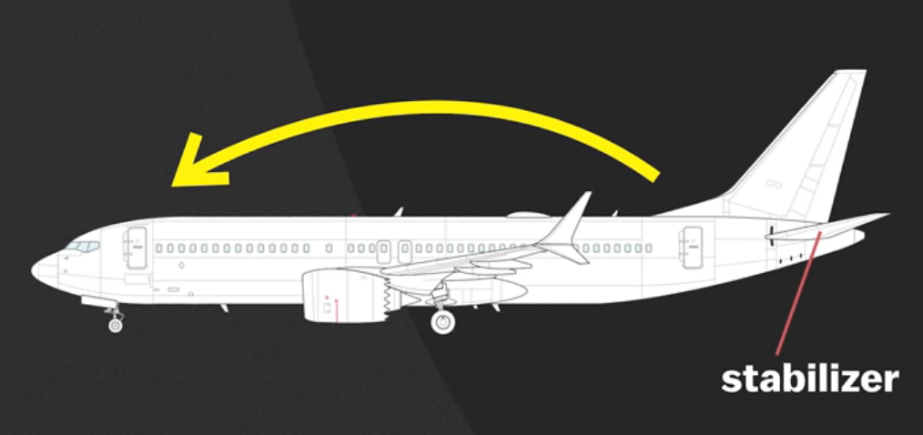
But..
Plane would go high up during takeoff due to the new positioning of the engine
Boeing’s Solution : MCAS
Maneuvering Characteristic Augmentation System

Slide 9
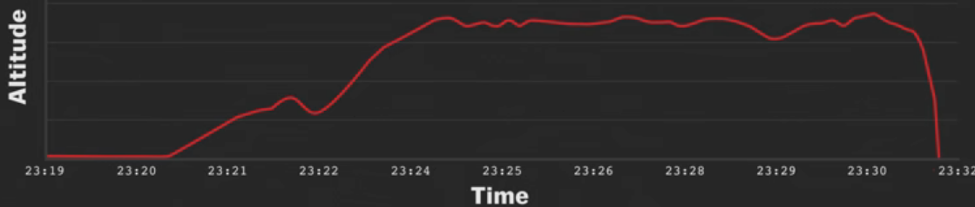
Accident and the MCAS
The New MCAS system kept pulling the nose of the aircraft down after takeoff
Pilot’s did not know about the MCAS in the first case and could not override it in the second case

Slide 10
Facts
Boeing did not mention the MCAS in their manual.
FAA still granted it the license.
Boeing told that no additional training is required for the pilots
Pilots complained that the aircraft nose kept dipping down
A total of 346 ( Lion 189 + Ethiopian 157) people died in the two crashes
After the two crashes all Boeing A737 Max have been grounded

Slide 11

Emotions flying around
Parties Involved:
Boeing Administration
Boeing Engineers
FAA
Pilots

Slide 12


Emotions : Boeing Administration
Fear of losing
Greed
Need to stay on the top

Slide 13

Emotions : Boeing Engineers
Pressure due to:
Complex Task
Lack of time
High specifications

Slide 14
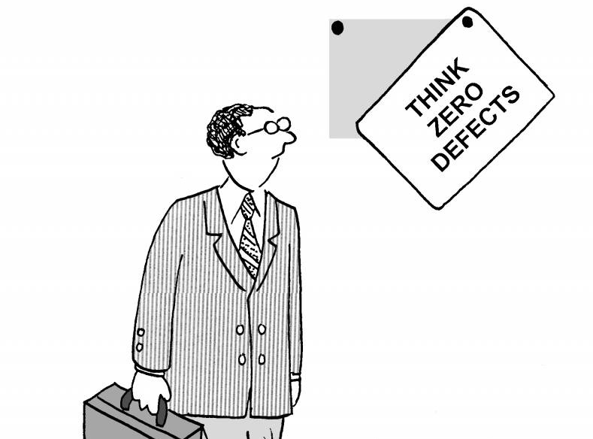
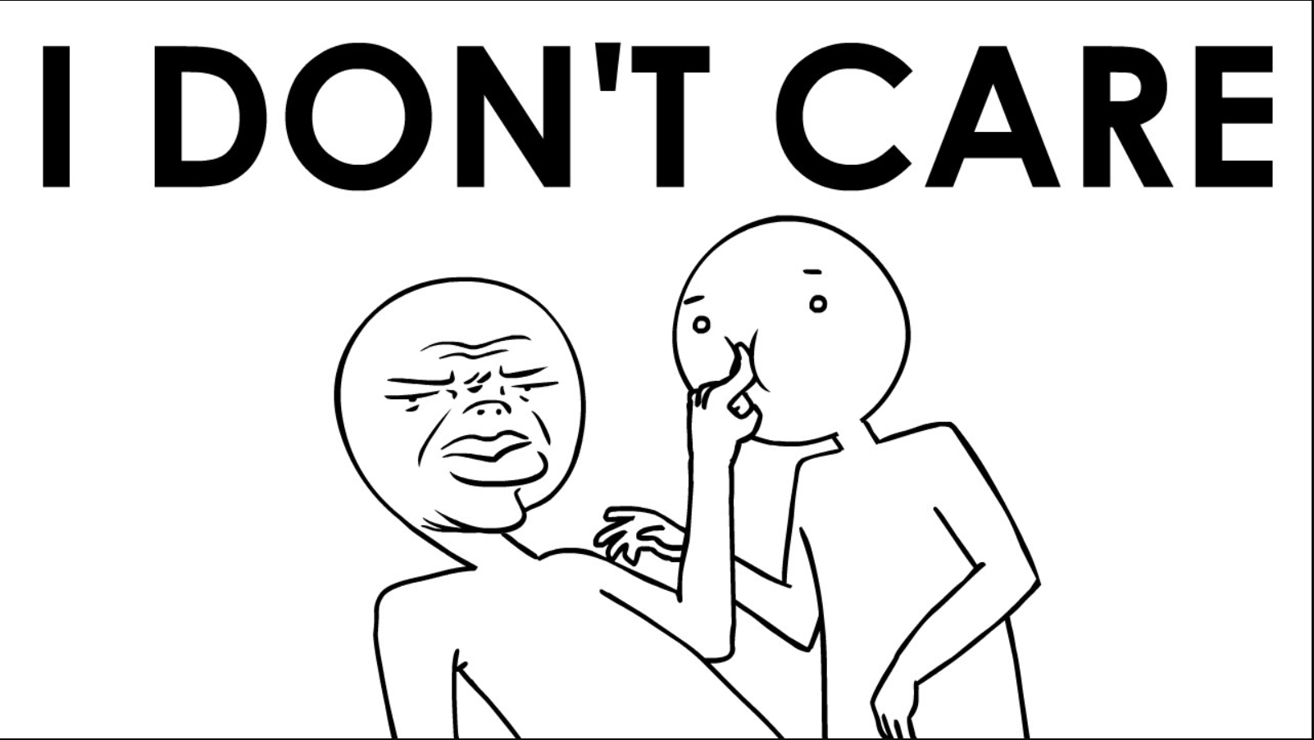
Emotions : FAA
Swayed by the name of Boeing
Not paying a heed

Slide 15


Emotions : Pilots
Overconfidence
Pressure from airline companies

Slide 16
Critical Analysis : Responsibility
The Boeing Company
Federal Aviation Administration
(FAA)
A governmental body of the United States with powers to regulate all aspects of civil aviation in that nation as well as over its surrounding international waters.
Administration
Engineers

Slide 17

Critical Analysis
The Boeing Company
What caused the problem?
Self- interest
Withholding information
Deception

Slide 18

Critical Analysis
The Boeing Company
What should they have done?
Legal & moral responsibility
Sacrificed Greed over Safety
Robust testing mechanism
1
2
3

Slide 19
Critical Analysis
The Boeing Company
Greed/ Unhealthy competition
Responsibility/ Safety
Trust gained !
Safety Compromised
Safety
Trust lost !
Trust maintained !

Slide 20
Critical Analysis
Federal Aviation Administration (FAA)
What it did?
Rushed through certification
FAA
Extra faith and belief
No intense testing

Slide 21
Critical Analysis
Everybody’s equal before the law, so, no faith on brand name!
Federal Aviation Administration (FAA)
What path it should
have followed?
Certification after a series of testings
Set up a robust and transparent testing mechanism for the aircrafts

Slide 22
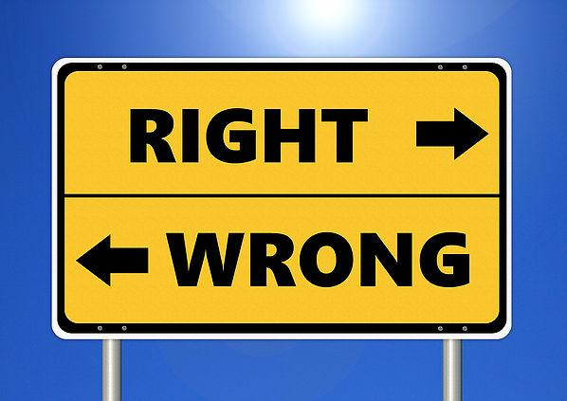
Conclusion & Group Opinion
Unethical Practices Done
MCAS Not Available In Manual
False claim of no need of training for the pilots
FAA certified Without Checking

Slide 23

Conclusion & Group Opinion
Ethical Must Be Done
Education And Training To Pilot
New Updates Must Be Available In Manual
Assessment Before Certification

Slide 24
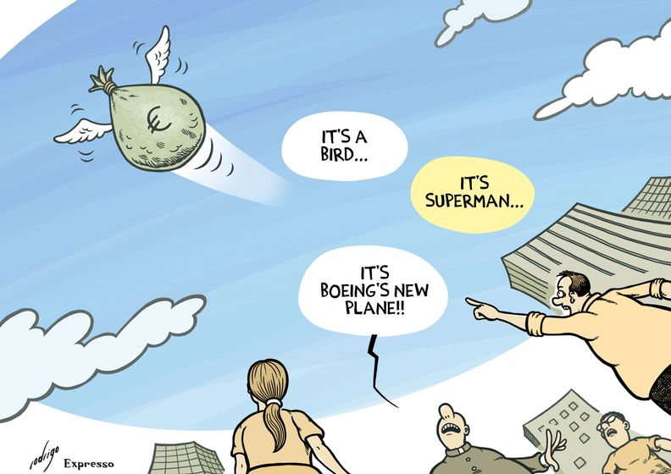
Conclusion & Group Opinion
This case shows how economic and competitive pressure led to the death of 346 people
Negligence from the FAA, wrong decisions of the Boeing’s Administration and Engineers are all equally responsible for the disaster
Even if one of them would have done their duties correctly then it would not have come to this situation

Slide 25
Thank You
References:
https://www.vox.com/business-and-finance/2019/4/5/18296803/boeing-737-max-scandal-ethiopian-airlines-crash-news-updates
https://www.rockdovesolutions.com/blog/boeings-reminder-of-the-number-1-rule-in-crisis-management
https://www.eetindia.co.in/news/article/Boeing-737-MAX-A-Question-of-Ethical-Engineering
https://www.vox.com/videos/2019/4/15/18306644/boeing-737-max-crash-video
https://blog.apaonline.org/2019/04/08/the-ethical-failures-behind-the-boeing-disasters/

